Slide 1
Industrial Communication µ-Projects
Amitojsingh Arora (3238617)
Shunnoy Sarkar (3660409)

Slide 2
To be noted
We have made the changes in the ISO OSI models.
The Link to our GitHub repo is:
https://github.com/AmitojsinghArora/IndCom

Slide 3
Contents µ Projects
Modbus RTU, TCP, HTTP
CAN Bus
IO-Link with ESP32 IO-Link Shield

Slide 4
Modbus Scope
RS485-based communication with Modbus temp/humidity sensor using ESP32.
ESP32 operating as:
HTTP Webserver (port 80)
Modbus TCP slave (port 502)
Wi-Fi Access Point
Sensor data displayed by:
REST API HTTP Endpoints (/temperature, /humidity)
Modbus TCP Registers (FC04)
Data visualisation in Node Red.

Slide 5
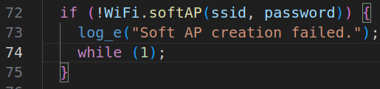
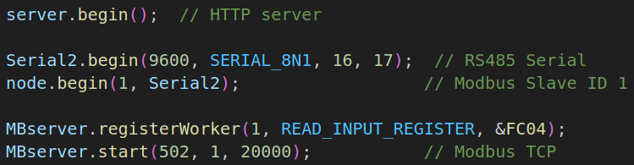
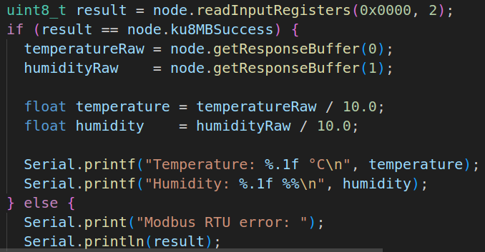
Modbus Code Insight
setup() : WiFi initialisation, Modbus RTU and Modbus TCP configuration & HTTP server startup. (node –obj of ModbusMaster; MBserver –obj of ModbusServerTCPasync)
Polling the RS485 sensor:
Sends a Modbus RTU request to the sensor for input registers starting at 0x0000
If true, stores data in global vars.
If false, prints error message.

Slide 6
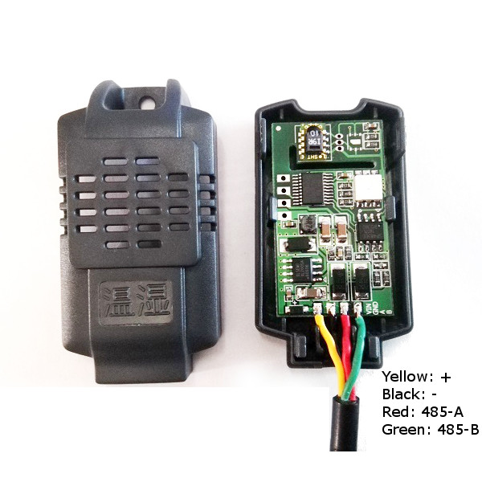
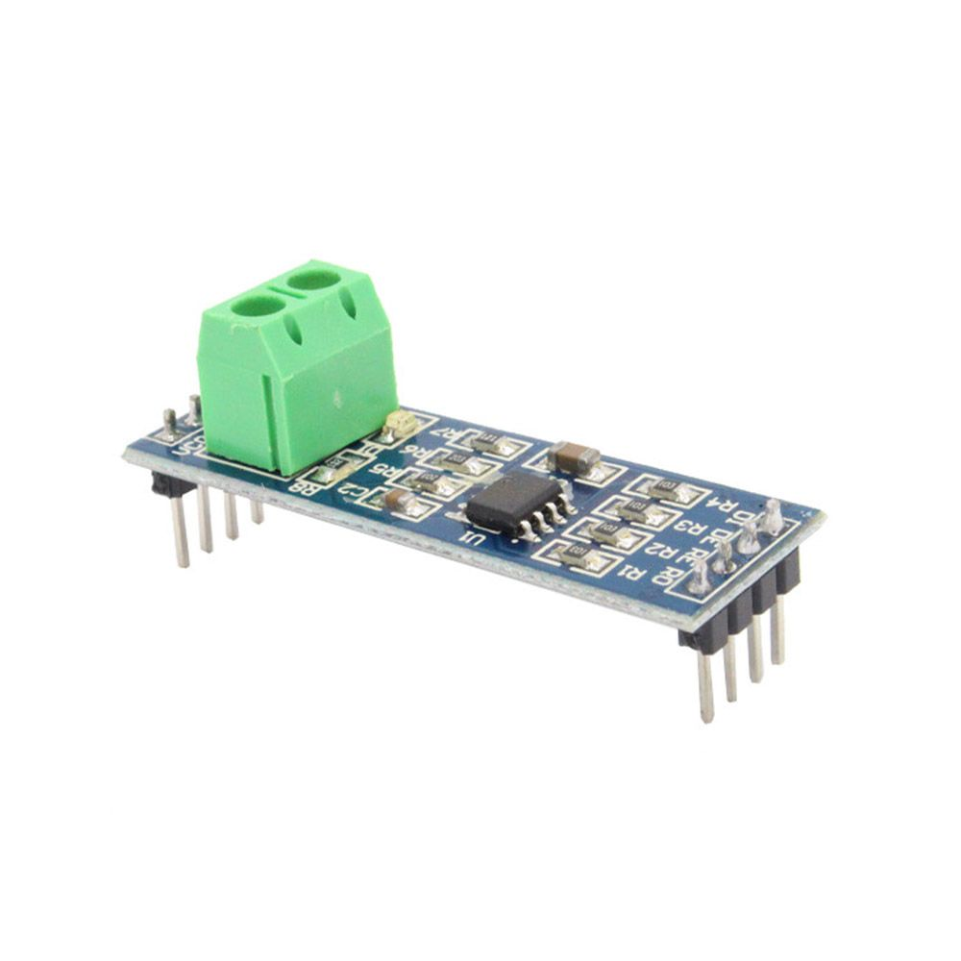
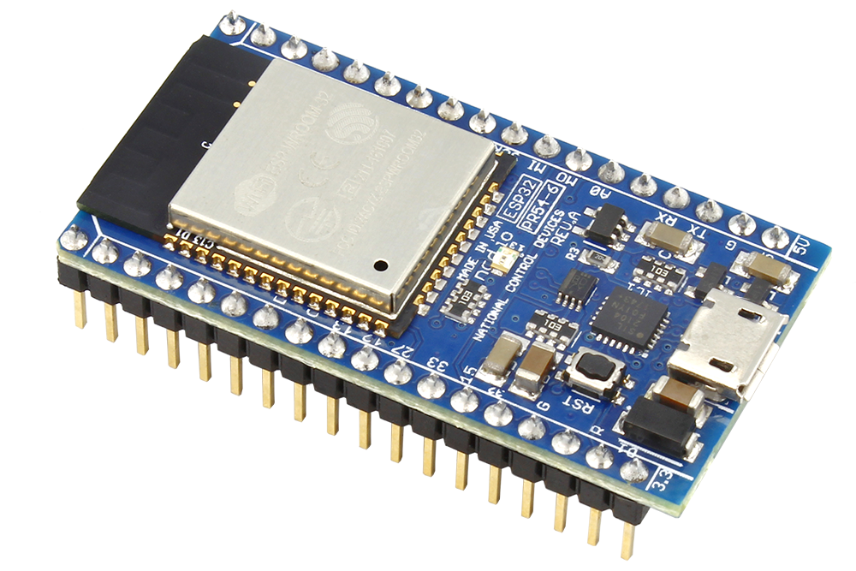

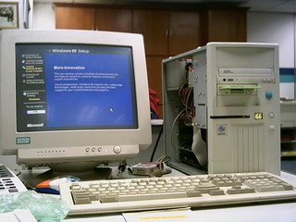
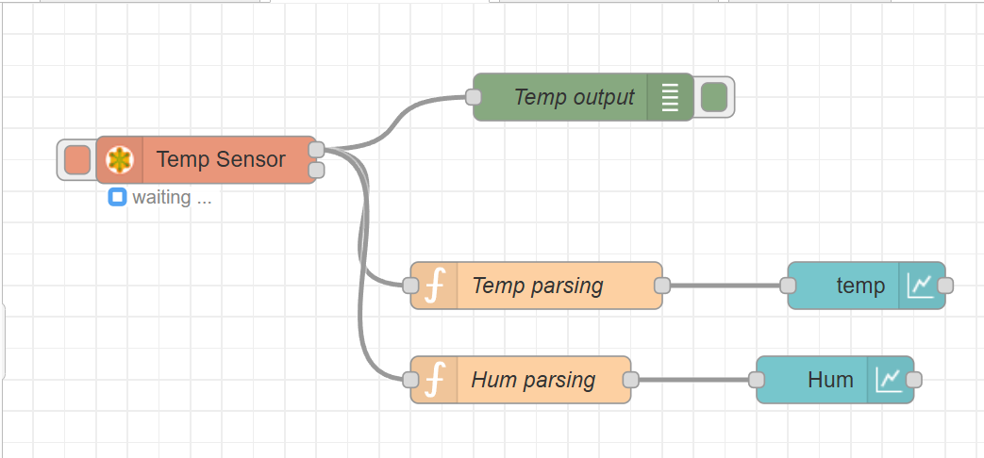
Modbus Setup
RS485 to TTL
ESP 32
Modbus Temp/ Hum sensor

Slide 7
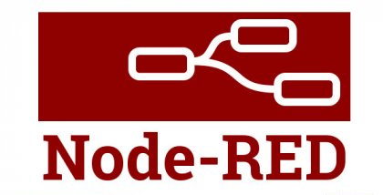
Modbus Communication Interface
PC
Node Red
App visualization
HTTP Client
Modbus TCP Client
ESP32
80
502
HTTP Server
Modbus TCP Server
Modbus RTU Server
Modbus RTU client
RS485
Modbus RTU Client & HTTP+Modbus TCP Server
Modbus Temp/ Hum sensor

Slide 8
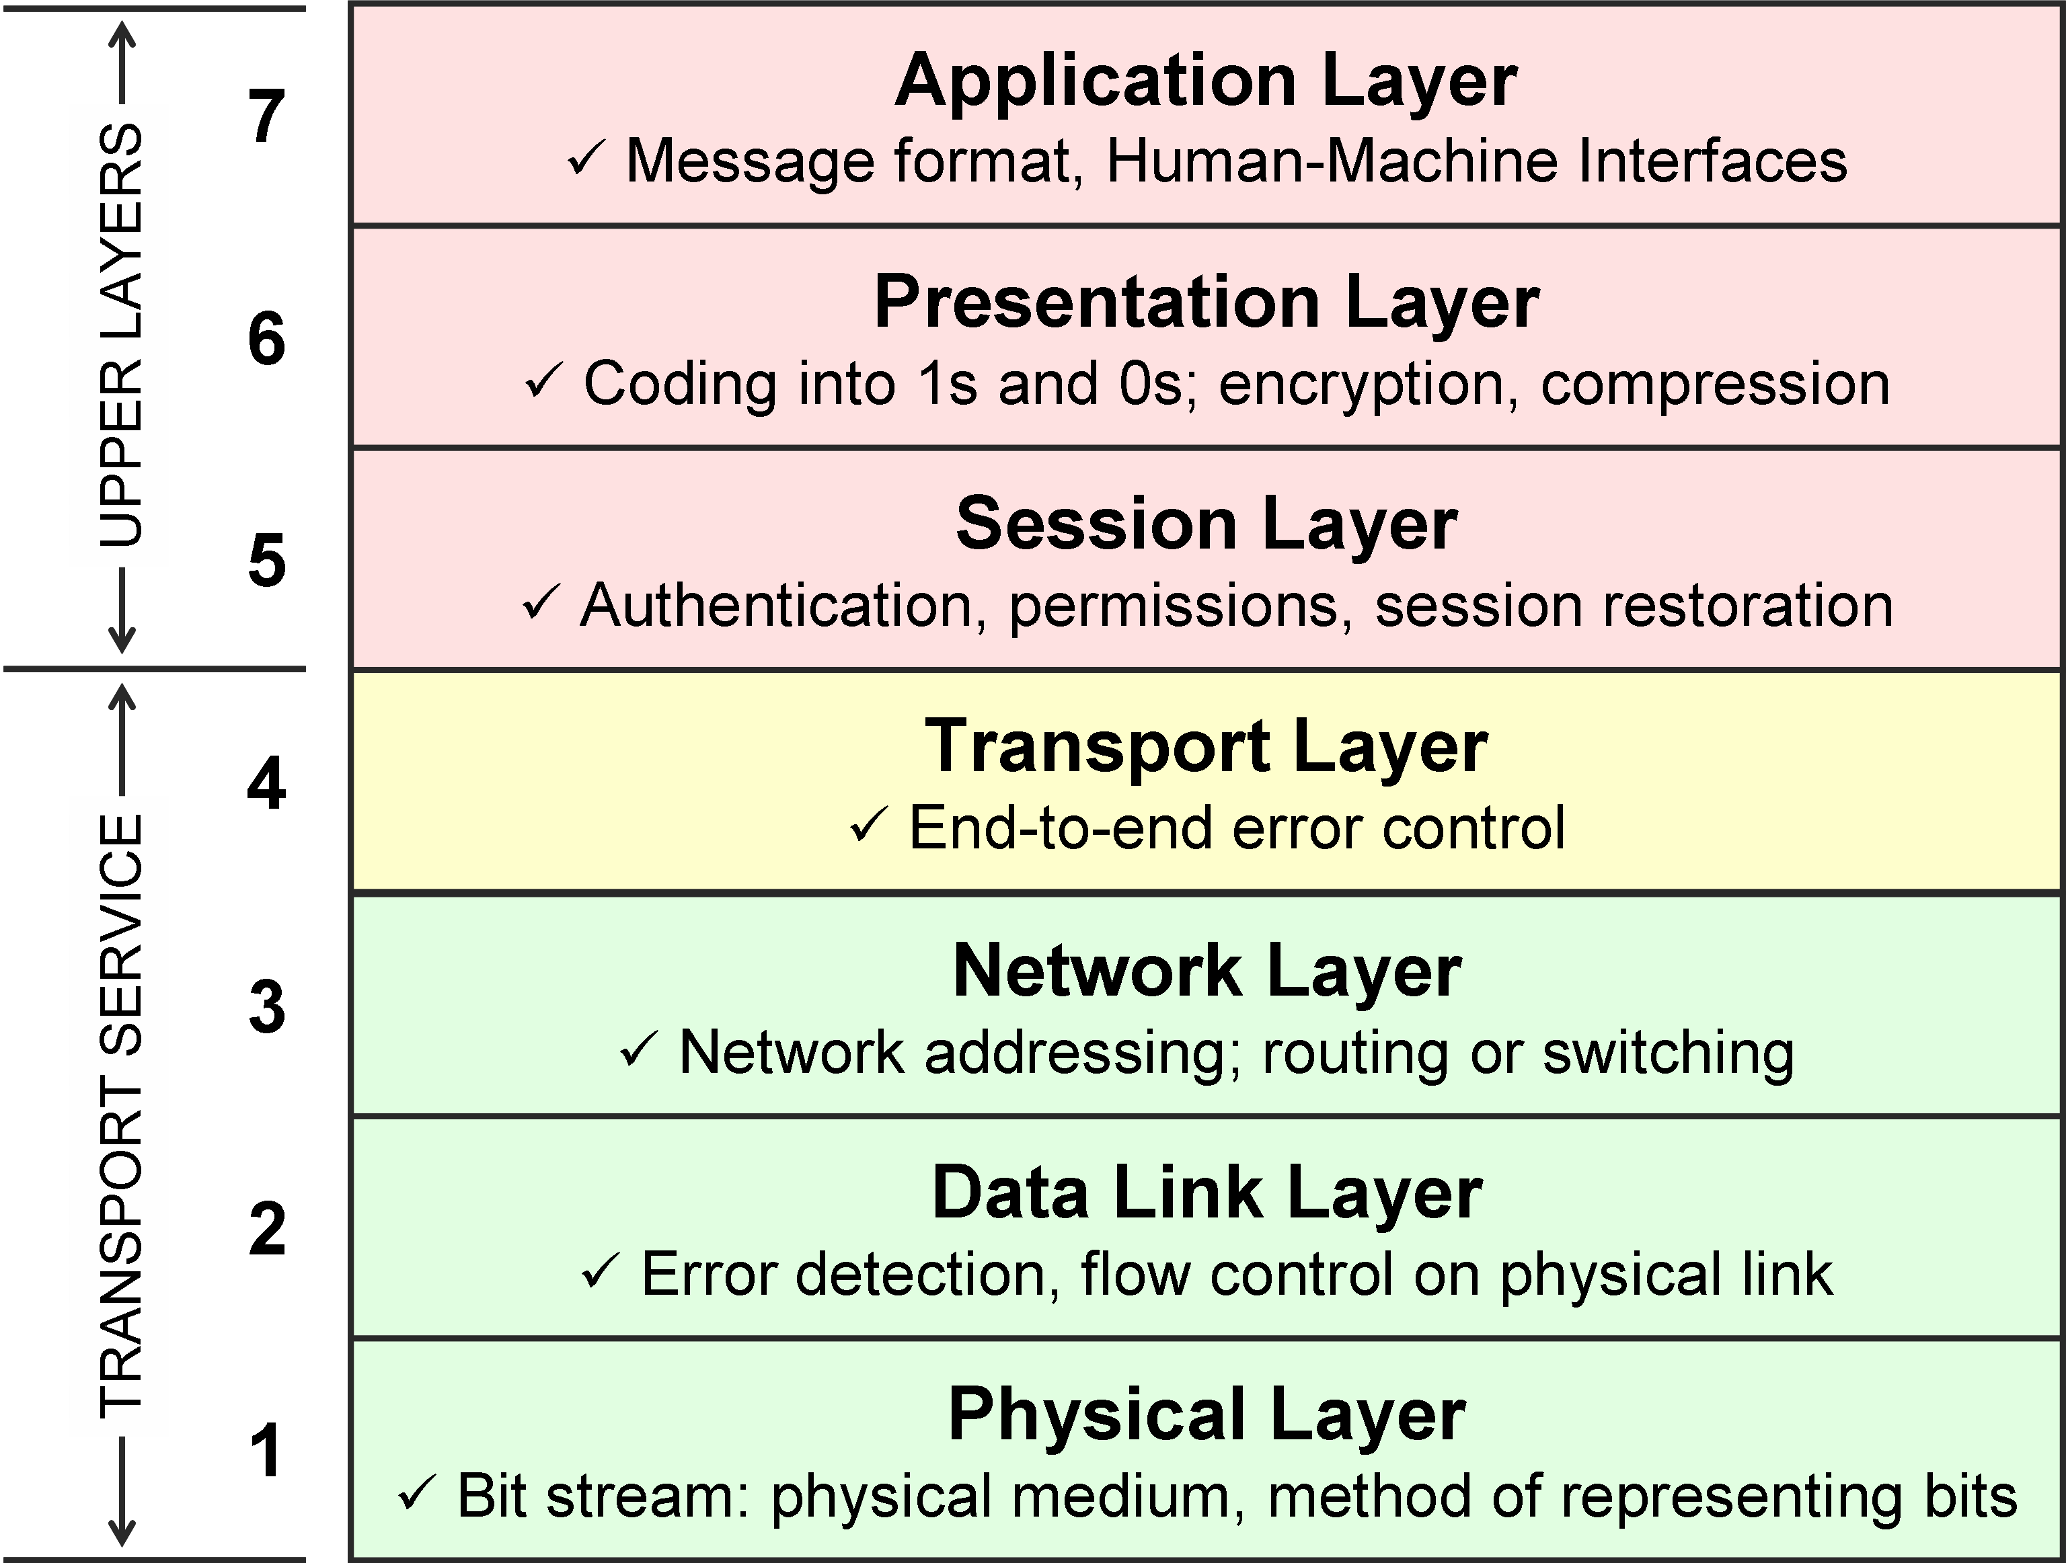
Modbus ISO OSI
Modbus RTU + TCP and HTTP
TCP (port 80 for HTTP and 502 for Modbus TCP)
IP v4 (Wifi AP)
802.11 (Wi-Fi)
RS 485

Slide 9
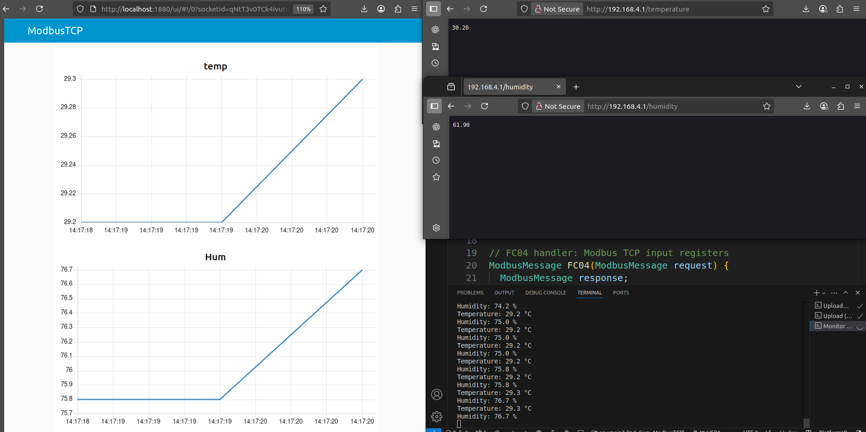
Modbus Results

Slide 10
Outcomes
Mini-tasks done:
Published time stamp on NodeRed (Intro to NodeRed)
Controlled an RGB LED over an HTTP server through a Wi-Fi Access Point created by ESP32-s.
Familiarised with Modbus RTU and TCP communication protocols and displaying obtained data over a Webserver via NodeRed.
Used QModMaster for verification of Modbus TCP communication.
Used Wireshark to identify recipient and sender of HTTP requests.

Slide 11
CAN Bus Scope
Practical introduction to CAN Bus Protocol
Sending and receiving CAN frames between ESP32 and USB CAN analyzer (connected to PC).
Adding the application layer (NodeRed) in which CAN data sent by ESP32 is visualised on the dashboard and data sent by serial port by NodeRed would be received by the MCU.
CAN J1939 Protocol Project:
Recognition of button trigger and rotation of a rotary knob via received CAN frames.
Controlling of LEDs on keys and segments with transmission of apt CAN frame data.

Slide 12
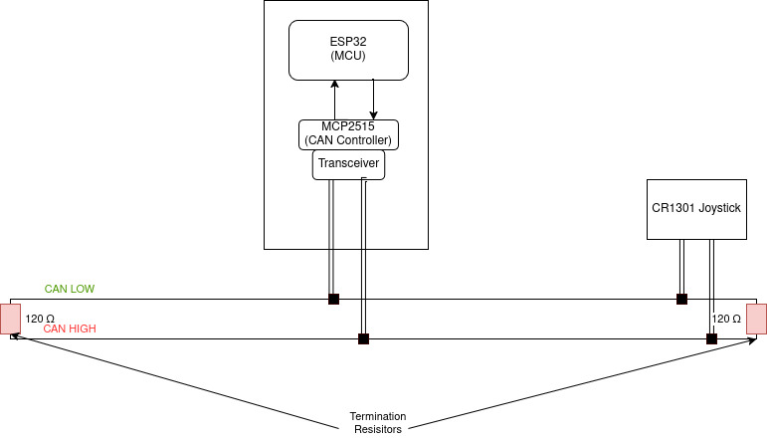
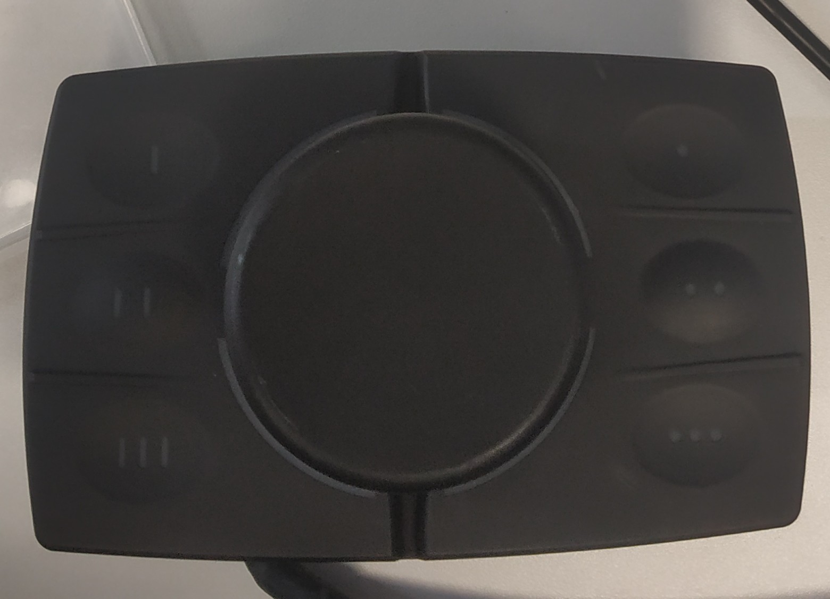
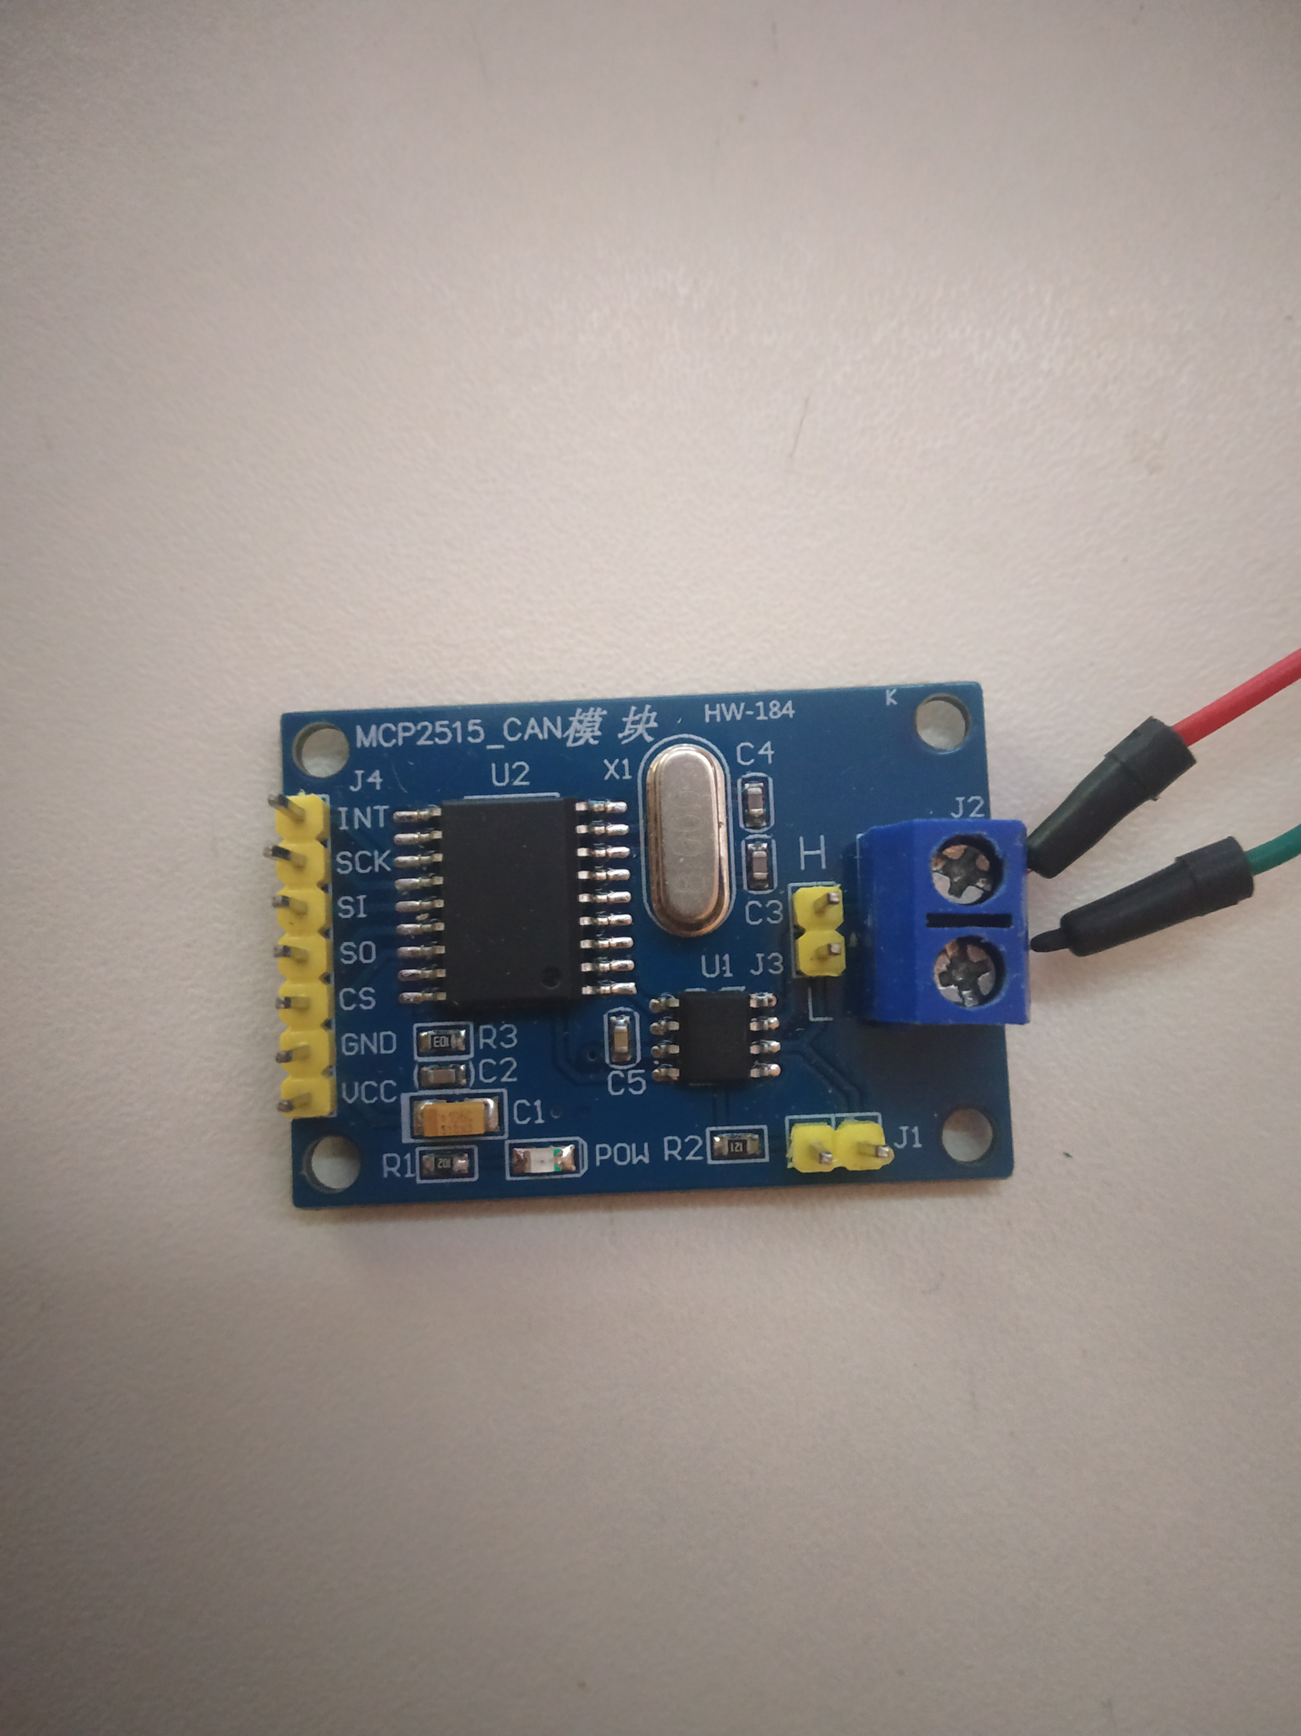
CAN Bus Simplified Hardware connections representation

Slide 13
CAN Bus ISO OSI
SAE J1939
CAN Protocol

Slide 14
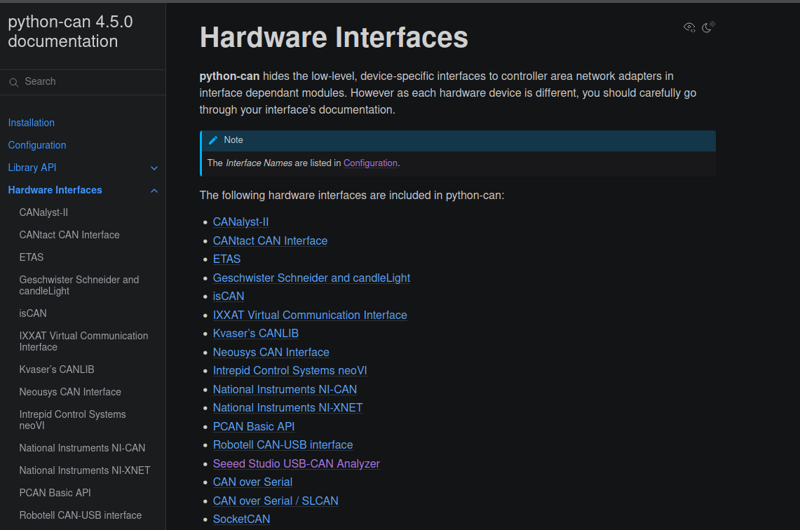
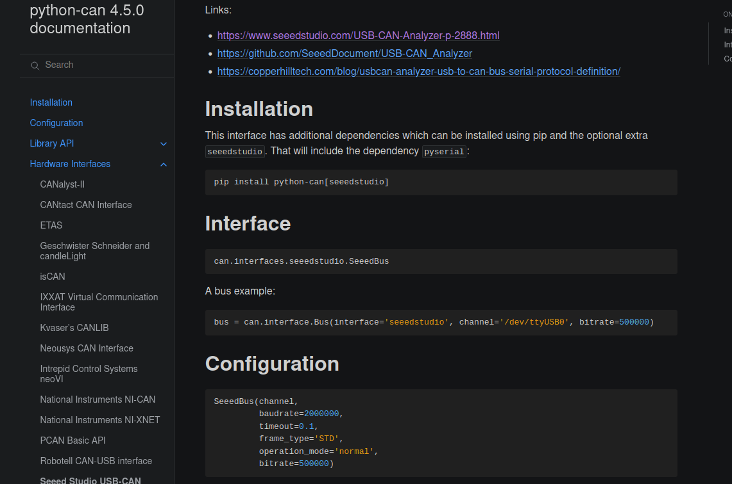
CAN Bus Alternate method: py-can

Slide 15
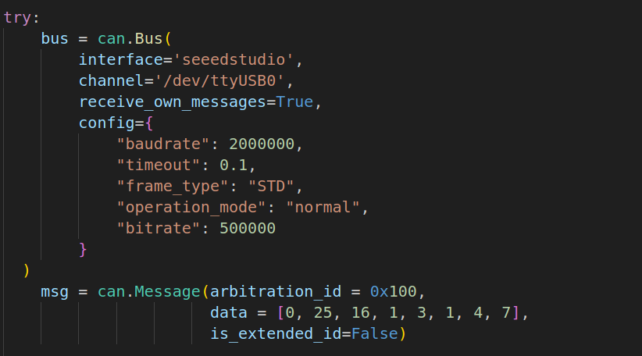
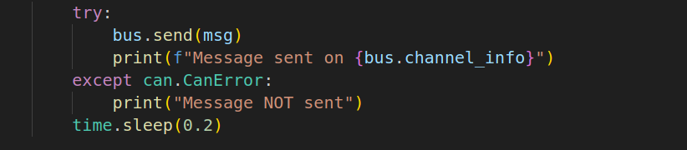
CAN Bus Send using py-can
can_serial_write.py:

Slide 16
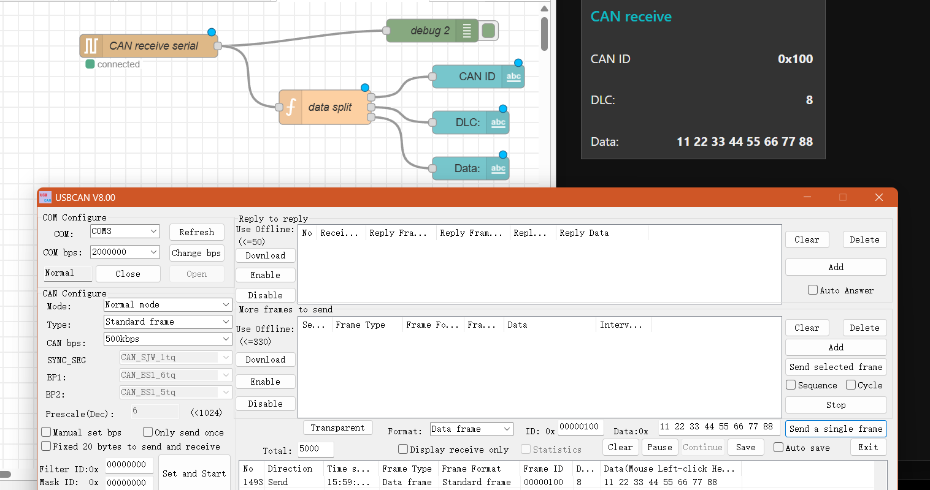
CAN Bus Send example

Slide 17
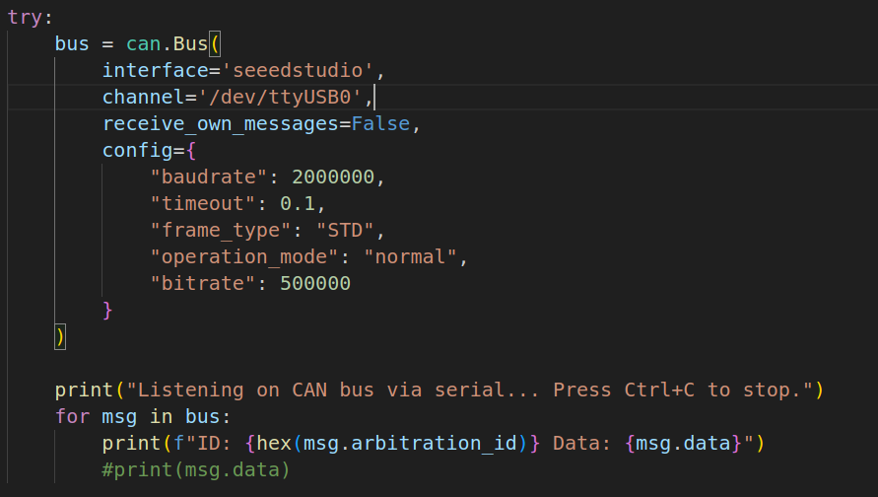
CAN Bus Receive using py-can

Slide 18
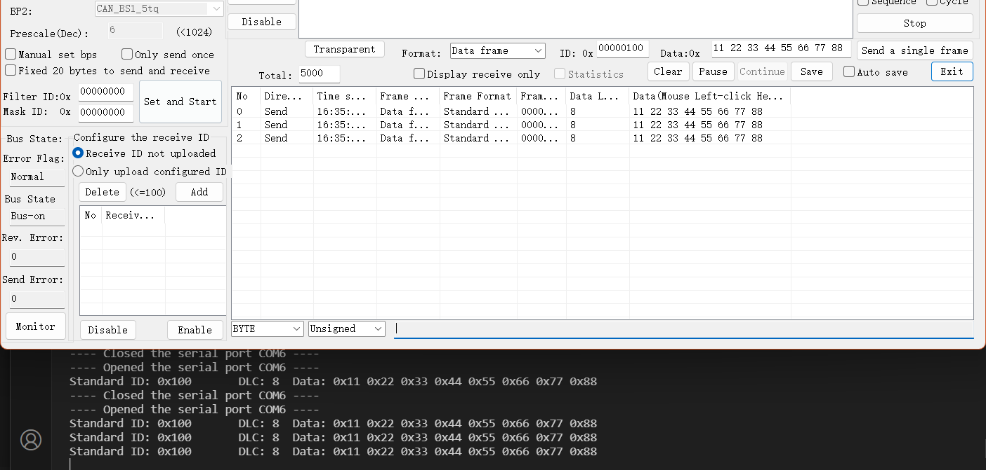
CAN Bus Receive example

Slide 19
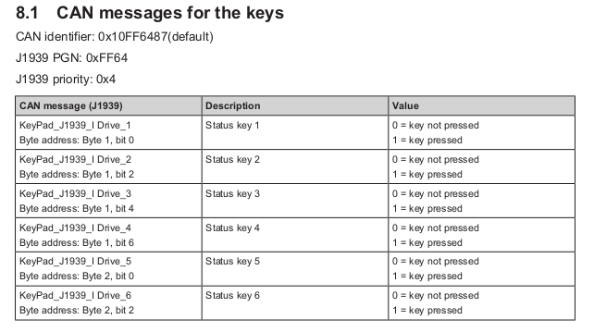
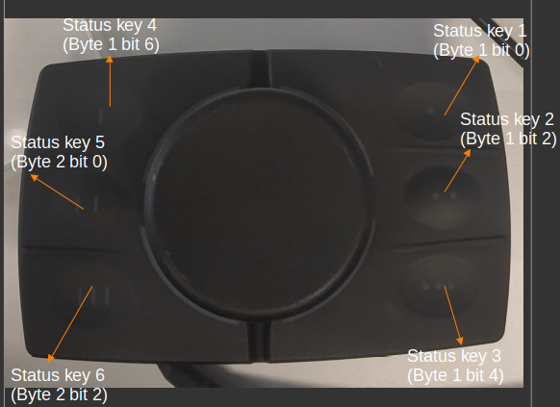
CAN Bus CR1301 Joystick control approach
Identifying and assigning the PGN, priority, src & dest addresses.
Identifying the keys to their respective labels.

Slide 20
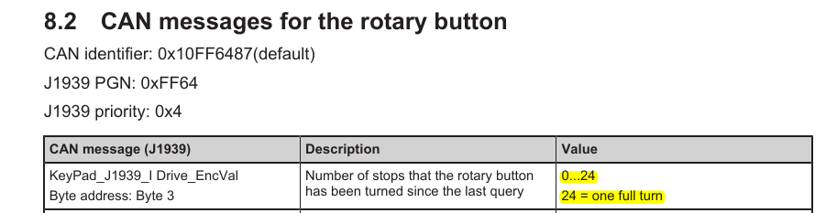
CAN Bus CR1301 Joystick control approach
3. Assigned two states for the entire system:
i) DEFAULT_POSITION_TRACKING : Segment lights up when rotated clockwise to yellow and changes colour ( as per the colour wheel given in lab manual) after every two shifts in encoder position, thus indicating the position of knob by 12 different colours for 24 identifiable stops.

Slide 21
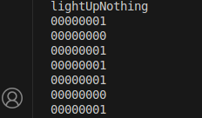
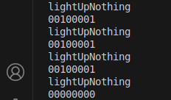
CAN Bus CR1301 Joystick control approach
ii) DETECT_DIRECTION: When the knob is rotated clockwise, the change of byte 3 is (bit 5 remains 0, as mentioned in manual, however bit 0 flips):
However when rotated anticlockwise, we observe:
Bits 0 and 5 are 1.
Thus for these triggers, the segment LEDs blink in the corresponding direction.

Slide 22

CAN Bus Result

Slide 23
ESP32 and IO-Link device Scope
Transmit sensor data over MQTT via IO Link Master
Setup MQTT via Mosquitto
Read data over MQTT Explorer
eff
d
Transmit Joystick data from ESP 32 over IO Link shield
Read joystick data via ESP 32
Transmit over IO link shield
Visualize on Node-Red

Slide 24
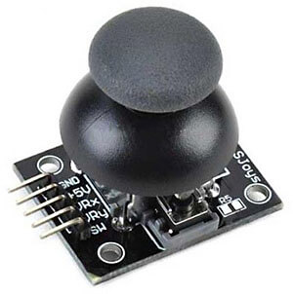
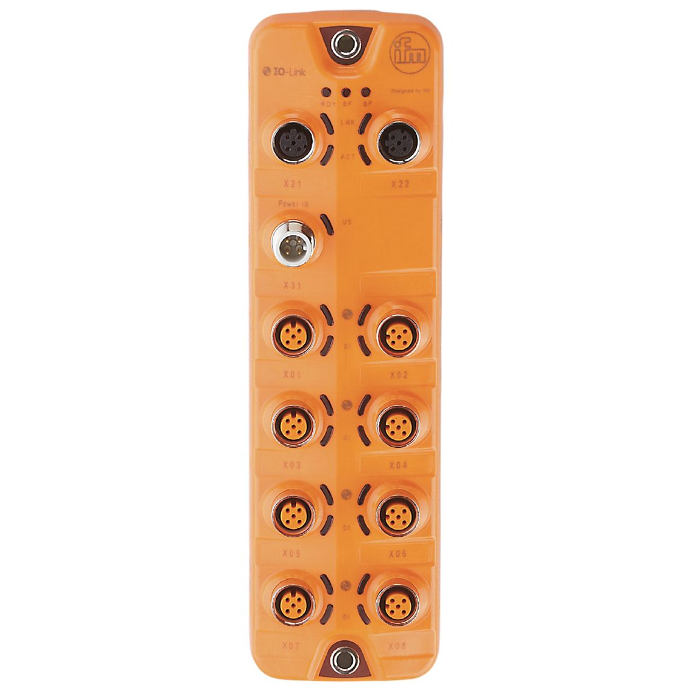
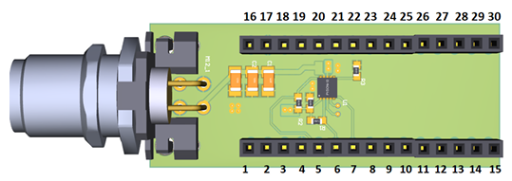
ESP32 and IO-Link device Hardware connection and Node-Red
Arduino joystick
Esp 32
Io link shield
Io link master

Slide 25
ESP32 and IO-Link device ISO OSI model
Node Red dashboard
MQTT + IODD
JSON
MQTT protocol (Session maintenance)
TCP (MQTT on port 1883)
IPv4
IO-Link master | MAC on LAN
 | Ethernet IEEE 802.3
ESP32 with joystick

Slide 26
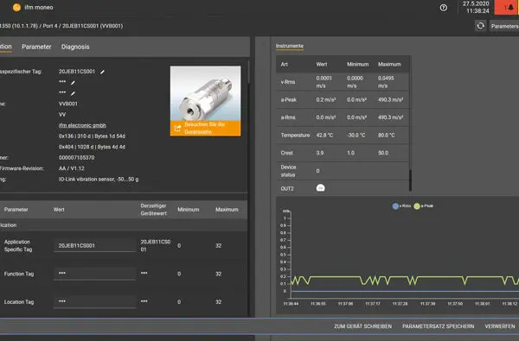
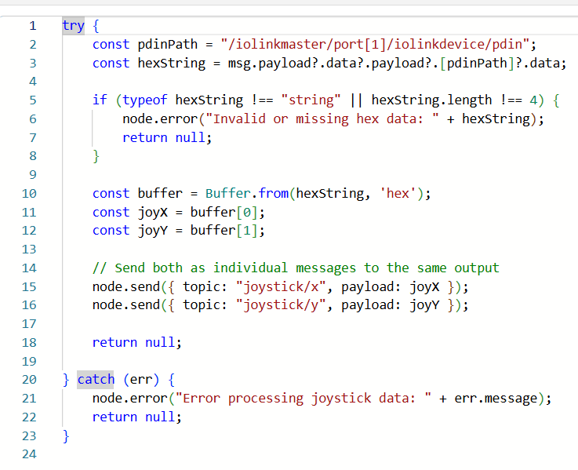
ESP32 and IO-Link device IO-link master and Node-Red
IO-Link topic generated on IFM Moneo
IO-Link topic
Generation of node red topics

Slide 27
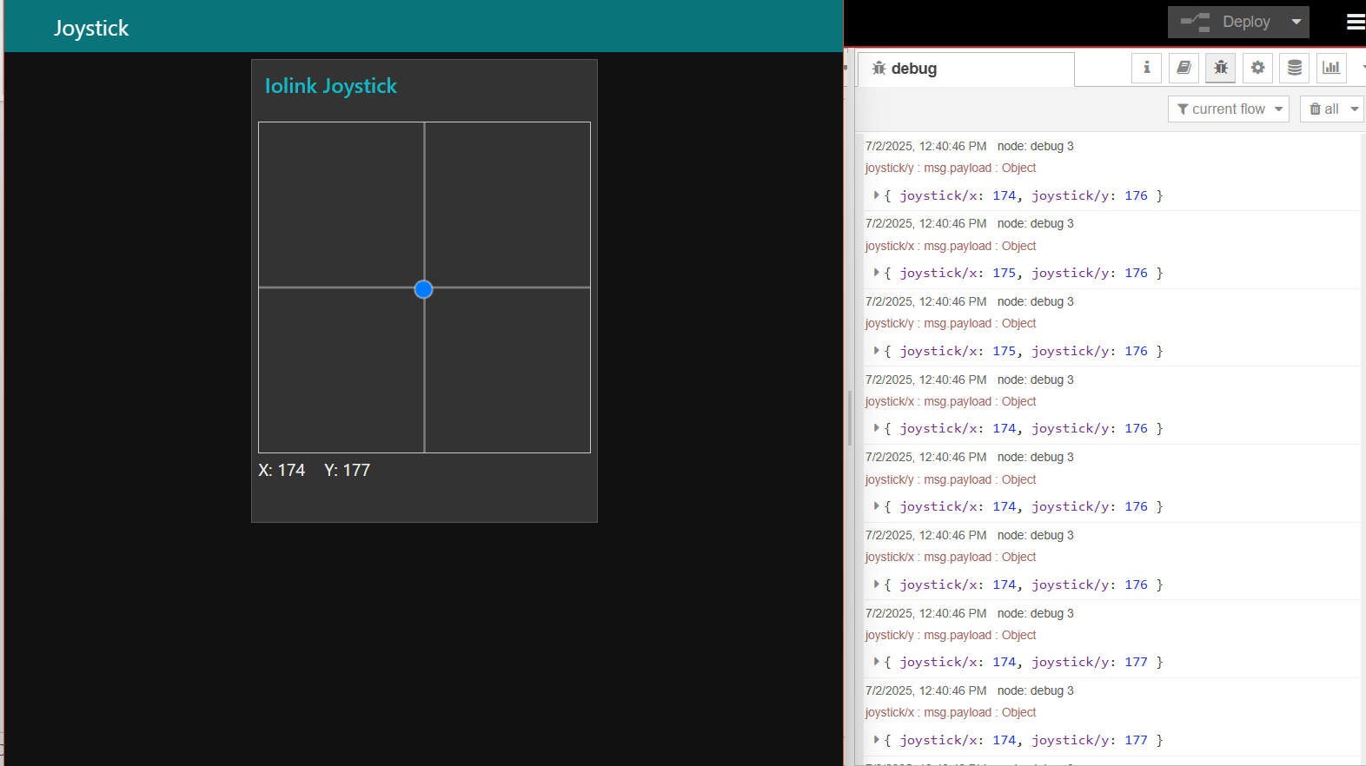
ESP32 and IO-Link device Node-Red Output

Slide 28
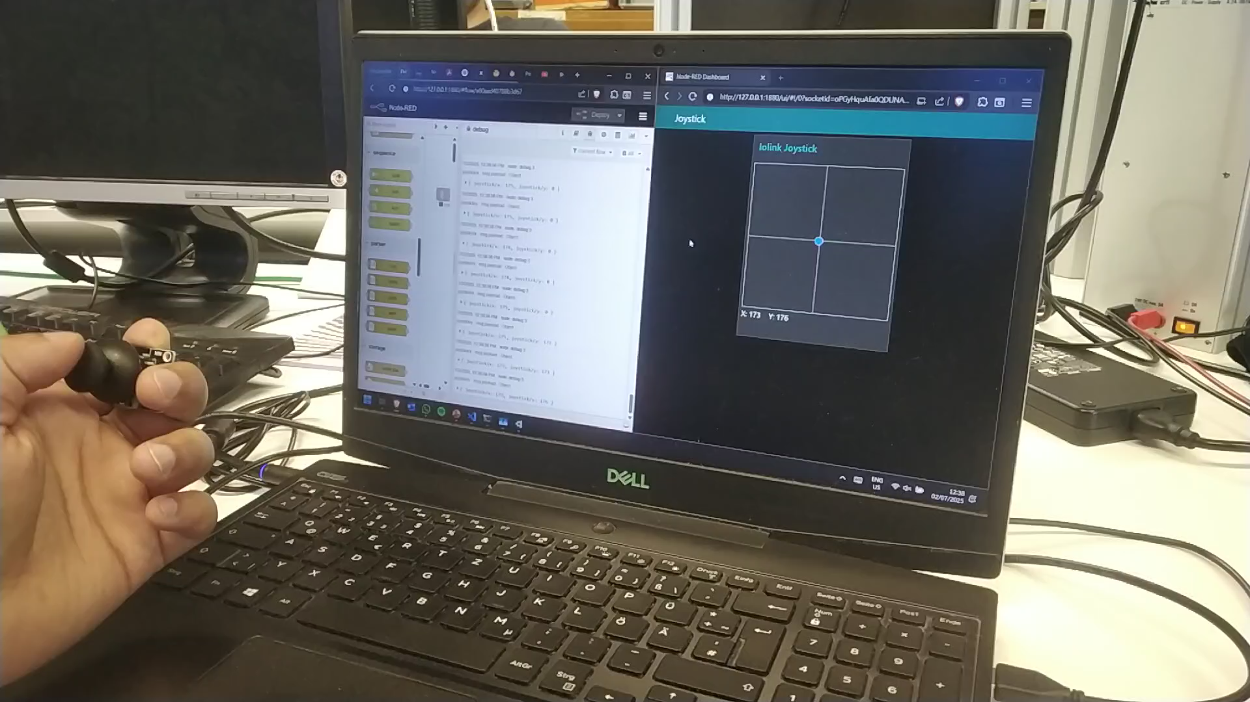
ESP32 and IO-Link device Node-Red Output

Slide 29
ESP32 and IO-Link device Challenges and Learning outcomes
Setting up the MQTT Broker over Mosquitto:
Config file had to be edited
Mosquitto had to be properly started over CLI
“C:\Program Files\mosquitto>mosquitto -c mosquitto.conf -v”
Setting up correct IP:
IO link master needed to have a specific IP (Moneo)
Laptop needed a static IP on the same subnet mask

Slide 30
Thank you and best wishes for the exams!

